Slide 1
Sustainable Development Goals (SDGs) in Agriculture
Innovative technologies for climate change mitigation by Mediterranean agricultural sector– Clima MED
LIFE17 CCM/GR/000087
https://life-climamed.eu/home

Slide 2
Sustainable Development Goals (SDGs)
In 2015, all the 193 nations that make up the United Nations (UN) jointly signed the, 2030 Agenda for Sustainable Development.
The agenda consists of 17 Sustainable Development Goals and 169 targets that are interlinked, meaning that action in one area will affect other areas .
The 17 SDGs provide a shared set of targets that aim for peace, environmental preservation, justice, social equality and support local communities.

Slide 3
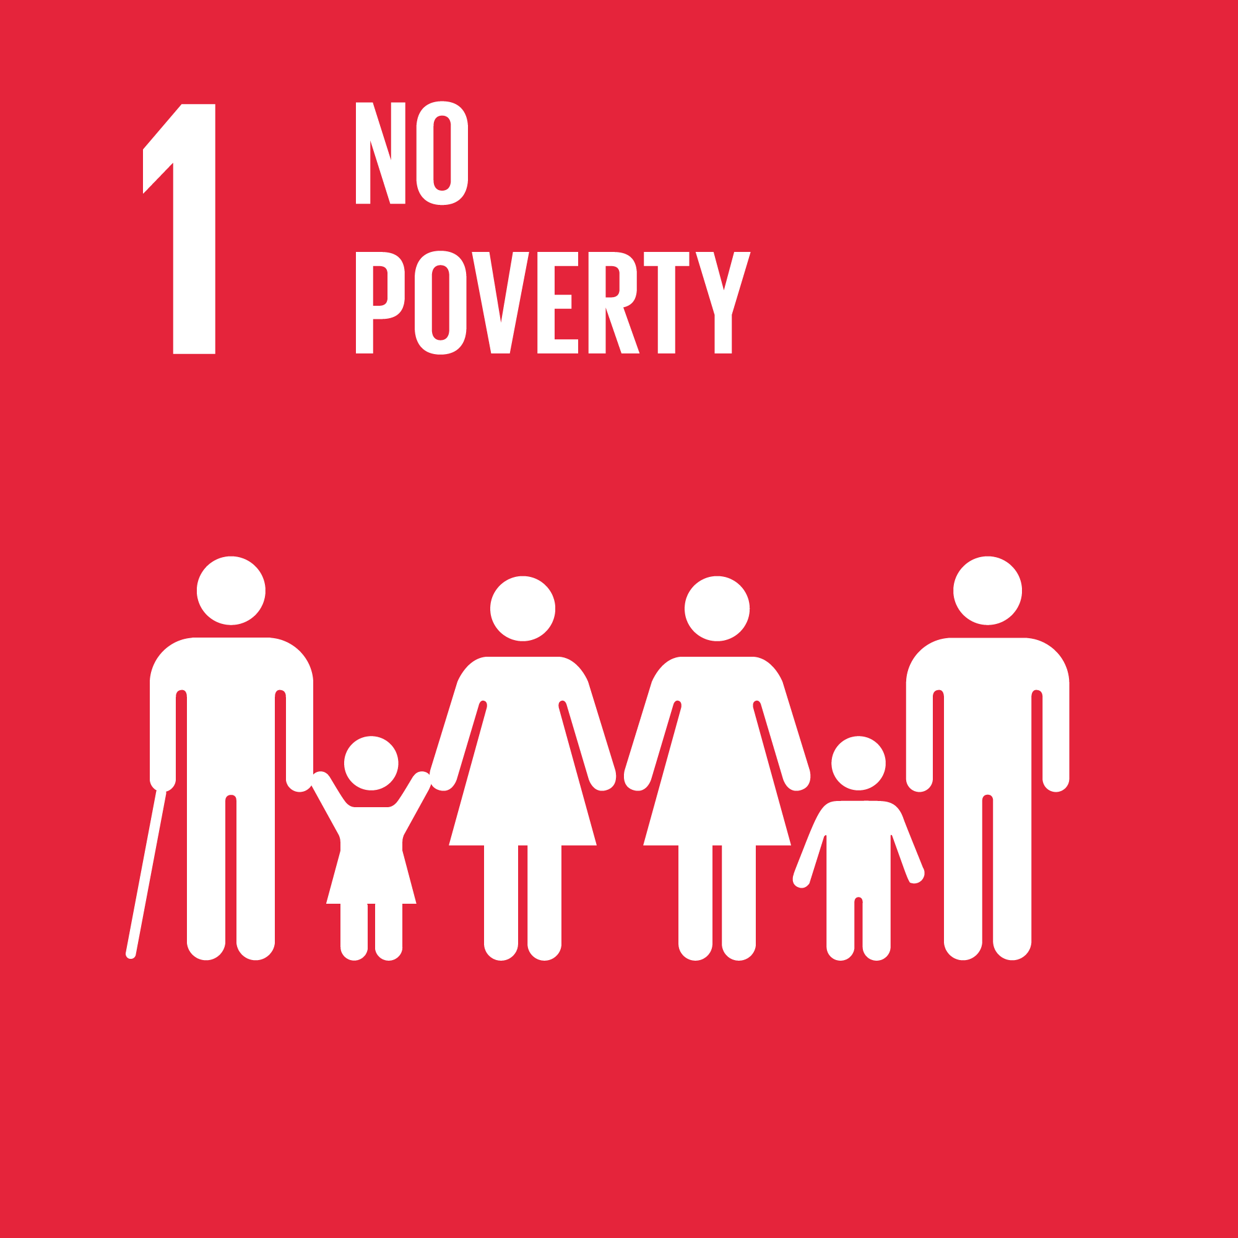
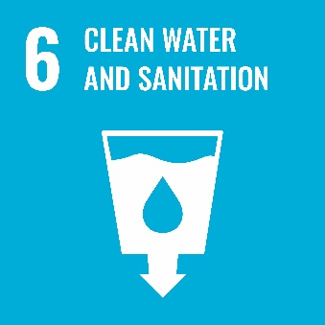
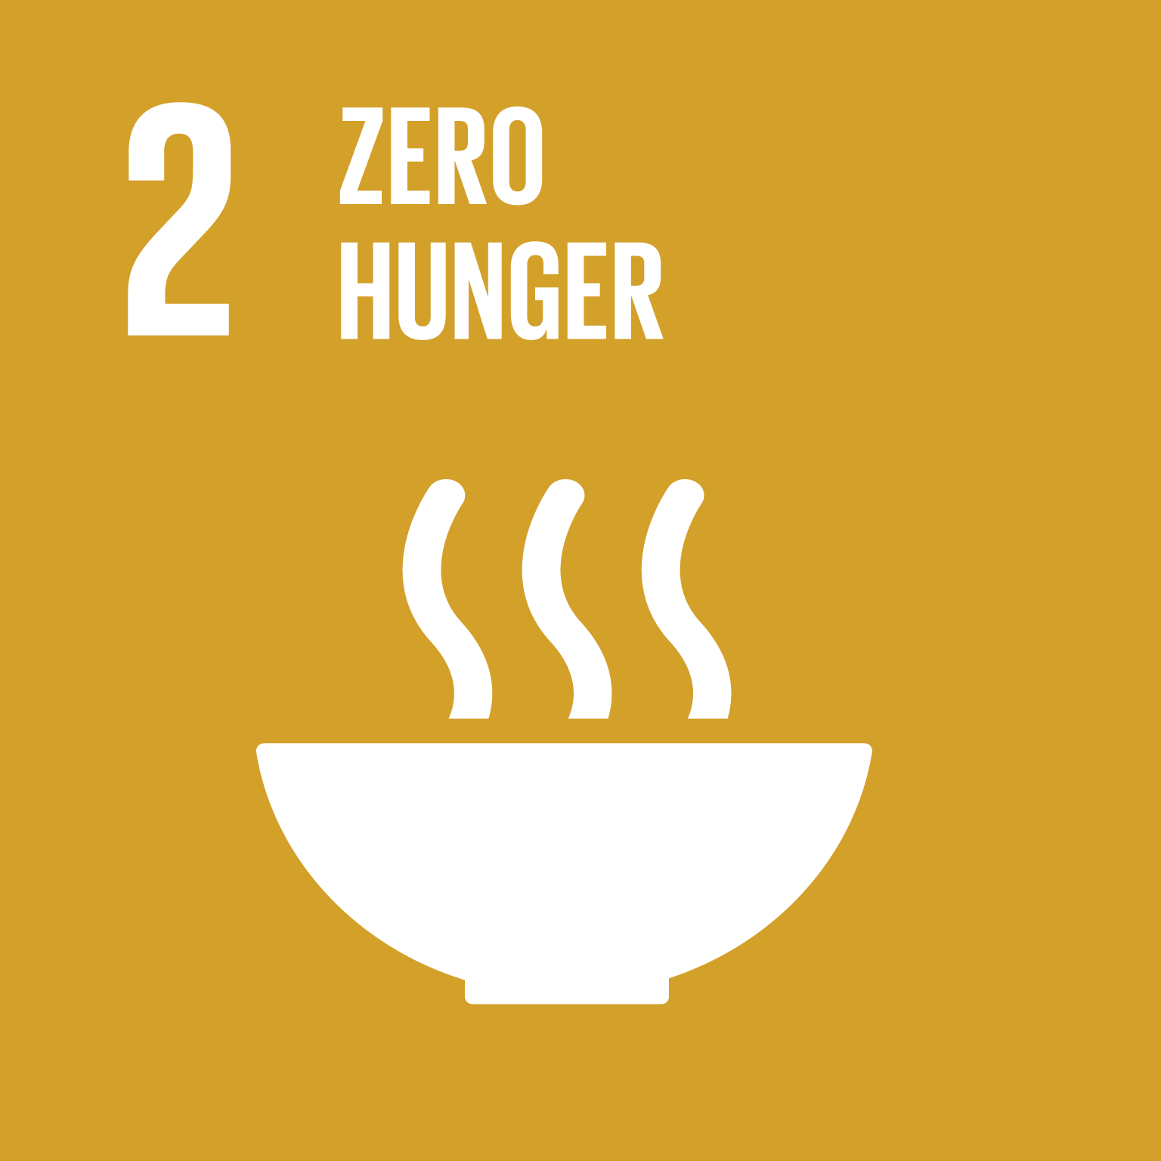
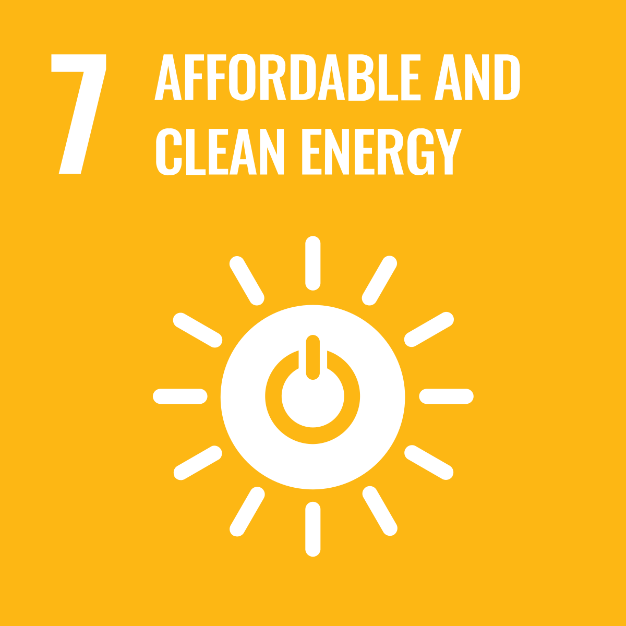
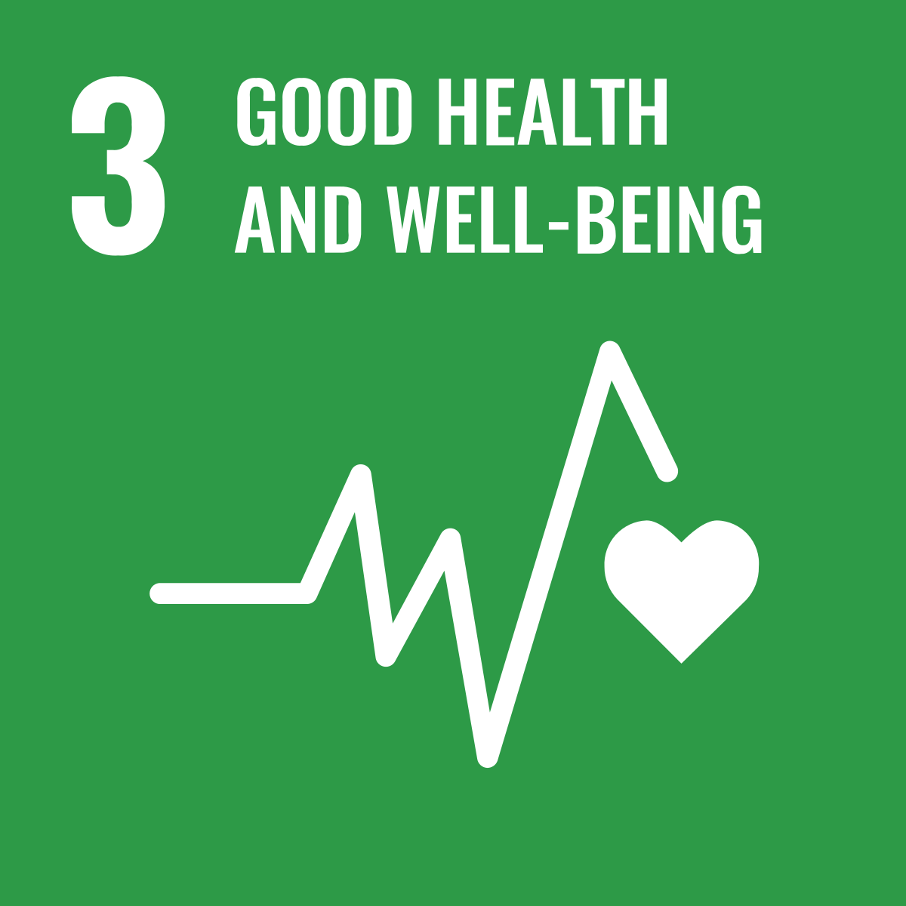
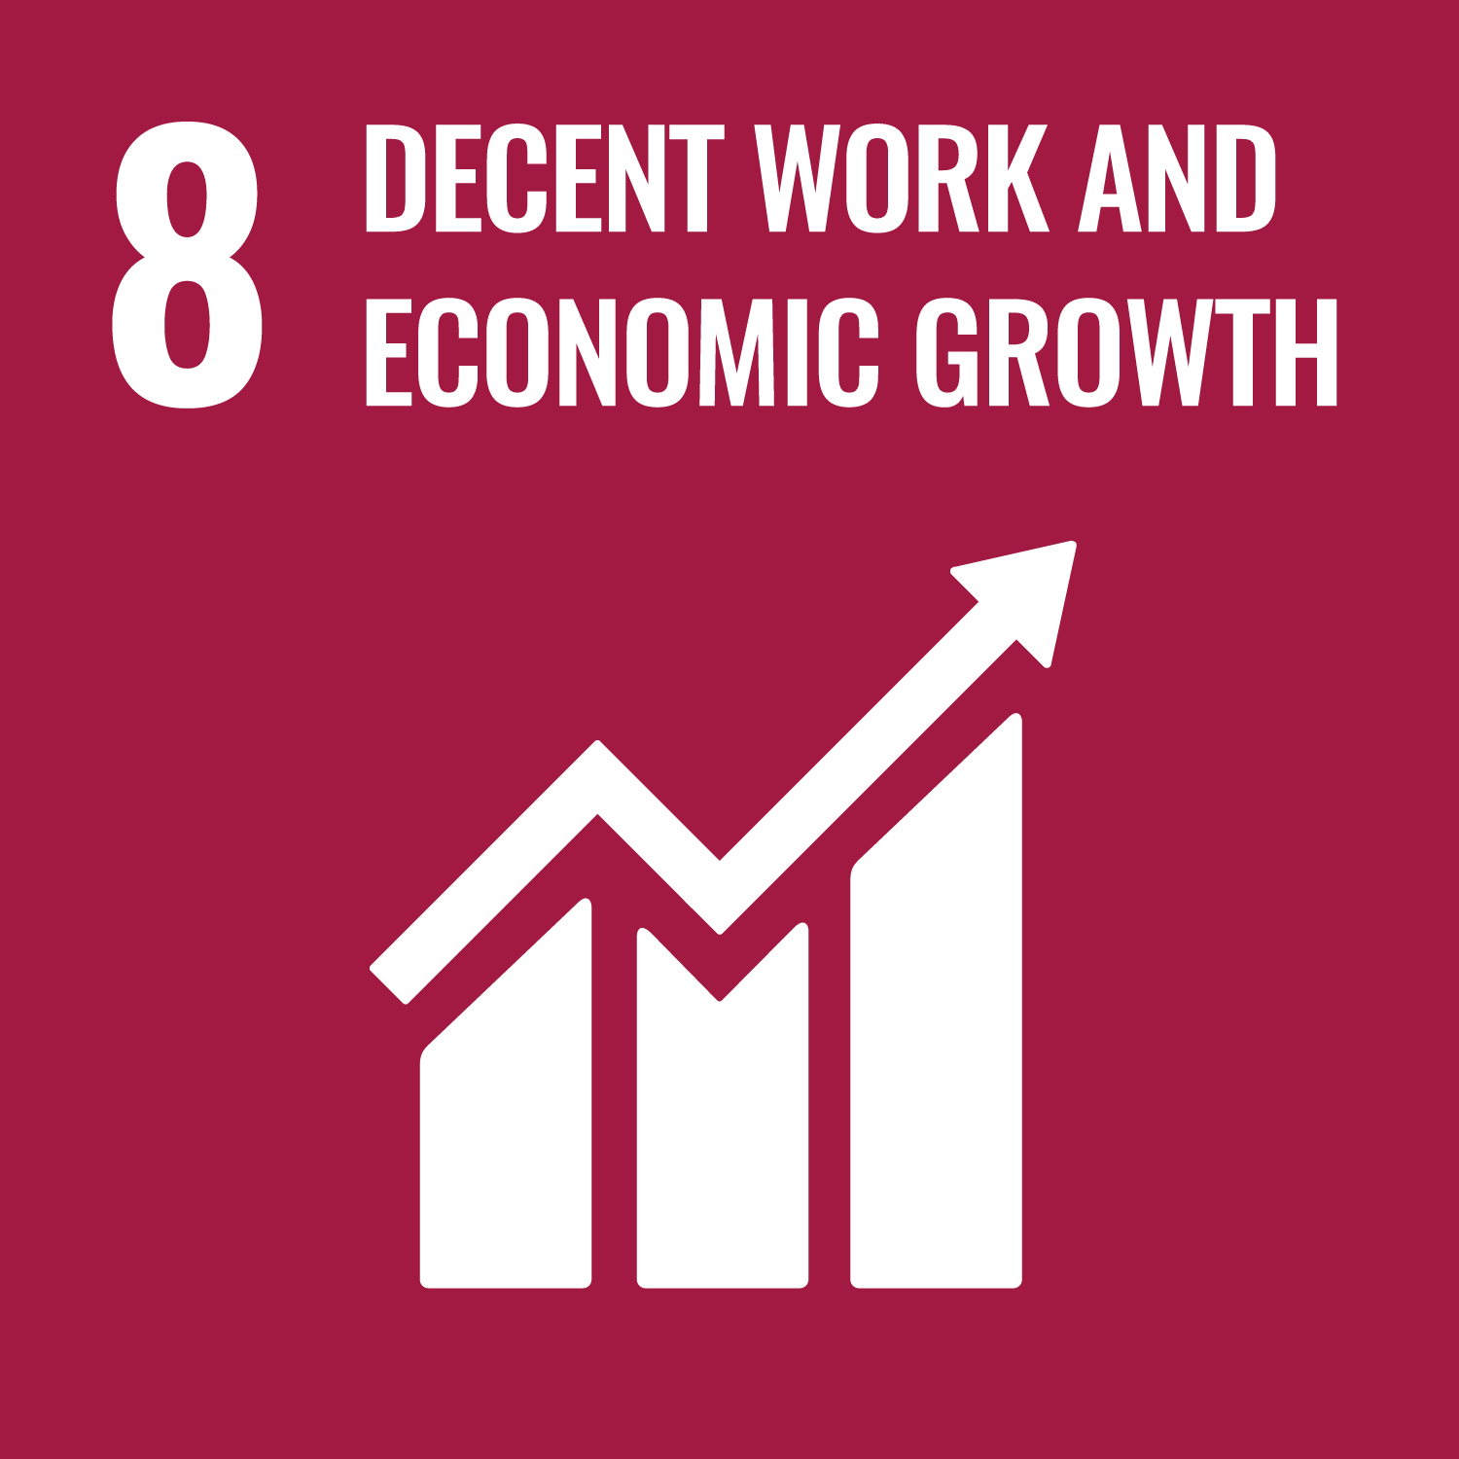



The 17 SDGs
Goal 1: No Poverty End poverty in all its forms everywhere.
Goal 2: Zero Hunger End hunger, achieve food security and improved nutrition and promote sustainable agriculture.
Goal 3: Good Health and Well-being Ensure healthy lives and promote well-being for all at all ages.
Goal 4: Quality Education Ensure inclusive and equitable quality education and promote lifelong learning opportunities for all.
Goal 5: Gender Equality Achieve gender equality and empower all women and girls.
Goal 6: Clean Water and Sanitation: Ensure availability and sustainable management of water and sanitation for all.
Goal 7: Affordable and Clean Energy: Ensure access to affordable, reliable, sustainable and modern energy for all.
Goal 8: Decent Work and Economic Growth: Promote sustained, inclusive and sustainable economic growth, full and productive employment and decent work for all.
Goal 9: Industry, Innovation, and Infrastructure: Build resilient infrastructure, promote inclusive and sustainable industrialization, and foster innovation

Slide 4
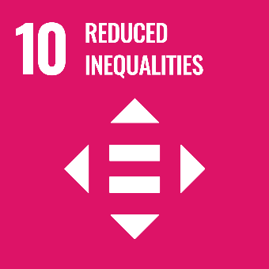
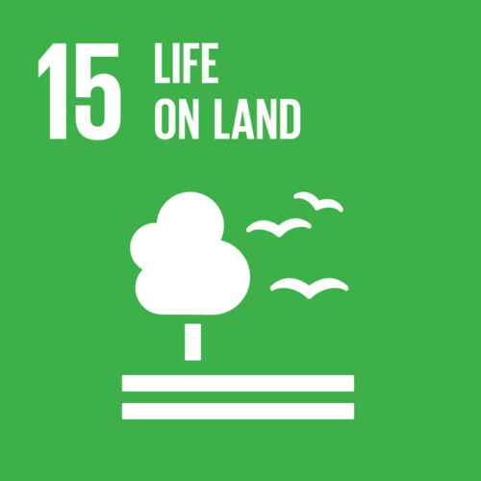
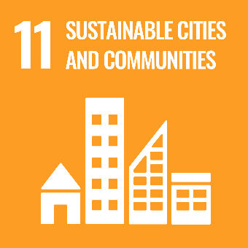
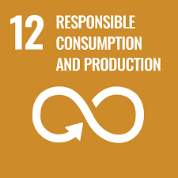



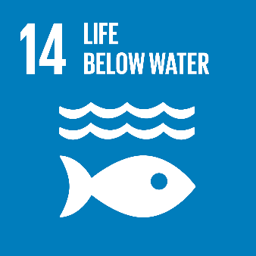
The 17 SDGs
Goal 10: Reduced Inequality: Reduce inequality within and among countries.
Goal 11: Sustainable Cities and Communities: Make cities and human settlements inclusive, safe, resilient, and sustainable.
Goal 12: Responsible Consumption and Production: Ensure sustainable consumption and production patterns.
Goal 13: Climate Action: Take urgent action to combat climate change and its impacts.
Goal 14: Life Below Water: Conserve and sustainably use the oceans, seas, and marine resources for sustainable development.
Goal 15: Life on Land: Protect, restore, and promote sustainable use of terrestrial ecosystems, sustainably manage forests, combat desertification, and halt and reverse land degradation and halt biodiversity loss.
Goal 16: Peace, Justice, and Strong Institutions: Promote peaceful and inclusive societies for sustainable development, provide access to justice for all and build effective, accountable, and inclusive institutions at all levels.
Goal 17: Partnerships to Achieve the Goal: Strengthen the means of implementation and revitalize the global partnership for sustainable development.

Slide 5
SDG 1: No Poverty
SDG 1: End poverty in all its forms everywhere
About 682 million people (8.5% of the world's population) lived in extreme poverty, that is, on less than $2.15 a day.
In Spain and Italy 10.3% and 7.5% of the population respectively live below extreme poverty
Extreme poverty is predominant in rural areas, where for a significant portion of the population agriculture is the primary source of income.
Improving agricultural activity and implementing sustainable farming practices, small scale farmers can increase their income, breaking the cycle of poverty. Sustainable practices can also enhance the long-term viability of farms and strengthen the resilience of the aricultural system.

Slide 6
SDG 1: No Poverty
Indicator | Long-Term Objective | Cyprus | Greece | Spain | Italy
Poverty headcount ratio at €2.05/day | 0 | 0.04 | 0.27 | 0.59 | 1.13
Poverty headcount ratio at €3.42/day | 0 | 0.06 | 0.6 | 0.88 | 1.77
Poverty rate after taxes and transfers | 0 |  | 11.5 | 14.7 | 14.2
What can be done?
Ensure access to quality education for all, empowering people to develop skills and acquire knowledge especially in agricultural sector
Implement well-designed schemes that support farmers in the event of natural disasters or vulnerable situations

Slide 7
SDG 2: Zero Hunger
SDG 2: End hunger, achieve food security and improved nutrition and promote sustainable agriculture
826 million people (1 out of 10) are affected by hunger
Globally, one out of three people suffer from some element of malnutrition, a serious condition identified by the poor nutritional value in peoples diet causing obesity, stunting or wasting
One out of ten people worldwide is undernourished, meaning they are unable to maintain a healthy life.
Agriculture is the primary source of food production and responsible for feeding the world population. Sustainable farming ensures the efficient production of food to meet the growing demands for the increasing world population, thus contributing to food security.
Agricultural sector provides a wide range of fruit, vegetables and animals essential for a nutrient balanced died. Promoting the cultivation of nutritious crops and increasing crop diversity can help to restrain malnutrition.

Slide 8
SDG 2: Zero Hunger
Indicator | Long-Term Objective | Cyprus | Greece | Spain | Italy
Prevalence of undernourishment | 2.5 | 2.5 | 2.5 | 2.5 | 2.5
Prevalence of stunning in children under 5 years age | 0 | 2.58 | 2.2 | 2.58 | 2.58
Prevalence of wasting in children under 5 years age | 0 | 0.7 | 0.7 | 0.7 | 0.7
Prevelance of obecity => 30 | 2.8 | 21.8 | 24.9 | 23.8 | 19.9
Human Trophic Level | 2 | 2.38 | 2.38 | 2.42 | 2.42
Cereal Yield | 7 | 1.99 | 4.27 | 4.23 | 5.56
Yield gap closure | 77 |  | 50.57 | 45.75 | 58.94
Sustainable Nitrogen Management Index | 0 | 1.23 | 0.68 | 0.78 | 0.77
Exports of hazardous pesticides | 0 |  | 23.47 | 13.47 | 4.38
On track or maintaining SDG achievement | Challenges remain | Significant challenges remain | Major challenges remain

Slide 9
SDG 2: Agriculture Contribution
Promote nutrition-sensitive agriculture and raise awareness about healthy eating habits to improve dietary diversity and nutrition
Ensure smallholder farmers have access to land, credit, and modern agricultural inputs such as seeds, fertilizers, and machinery
Develop and promote the use of high-yielding, drought-resistant, and disease-resistant crop varieties to increase agricultural productivity
Implement practices such as intercropping, agroforestry and crop rotation that improve soil fertility and enhance biodiversity
Optimize nitrogen fertilizers application by using slow release fertilizers and increasing the soil organic matter

Slide 10
SDG 3: Good Health and Well-Being
SDG 3: Ensure healthy lives and promote well-being for all at all ages
Target 3.9: By 2030, substantially reduce the number of deaths and illnesses from hazardous chemicals and air, water and soil pollution and contamination.
The preventable number of deaths from the reduction of chemicals in the environment is estimated to be 1.6 million people.
The use of chemical substances and fertilizers can have severe environmental and health impacts, by contaminating food, freshwater sources and the air. The main pathway for the hazardous chemicals is through food and liquid intake. Causes of death are mainly attributed to cardiovascular diseases, chronic kidney disease and poisoning.
Animals pose the threat of transferring and spreading zoonotic diseases to human-beings that can severe impact on health and with some of them turning to be deadly (e.g. H1N1)

Slide 11
Goal 3: Good Health and Well-Being
Agriculture practices can influence the safety of the food supply. Implementing proper agricultural practices and food safety measures during production, processing and distribution is essential to avoid the spread of diseases and promote public health. Protective measures include:
Minimize pesticide use by practicing integrated pest management
Implement practices that optimize the use of fertilizers and prevent water contamination, such as precision farming and slow release fertilizers
Provide access to healthcare services, and address occupational health risks in the agricultural sector
Promote the importance of sanitation for the humans and livestock to prevent the spread of diseases

Slide 12

SDG 5: Gender Equality
SDG 5: Achieve gender equality and empower all women and girls
Gender equality refers to the equal rights and opportunities of women and men and of girls and boys, to live without discrimination including workplace or any violence. Its vital to empower women to participate in leadership positions at all levels of decision making (political, social and economical).
Women earn 77 cent for every dollar a man gets for the same work
Women represent just 13% of agricultural landowners
Two thirds of developing countries have achieved gender parity in primary education

Slide 13
SDG 5: Agriculture Contribution
It has estimated that women can increase yield productivity by 20-30% if they were provided with the same access to economic and agriculture resources with men.
Gender equality encourages young women and girls to pursue careers in agriculture and agribusiness, contributing to the sector's vitality and innovation.
Women often have traditional knowledge and practices related to sustainable agriculture, seed saving, weather patterns and natural resource management. By that they can help improve the resilience of agricultural systems.

Slide 14
SDG 5: Agriculture Contribution
What can be done?
Develop and implement gender-responsive agricultural policies that address women's needs and rights.
Facilitate women's access to markets, financial services, processing facilities, and value chains, enabling them to earn fair prices for their products.
Raise awareness and work to reduce gender-based violence in agricultural communities, creating safe and respectful environments for women

Slide 15

SDG 6: Clean Water and Sanitation
SDG6: Ensure availability and sustainable management of water and sanitation for all.
The sector accounts for 70% of global water withdrawal. As food production demand is expected to increase up to 70% by 2050, securing water resources is crucial.
The use of fertilizers, pesticides and other agrochemicals, is a serious threat for water bodies. If not managed properly, they can leach to groundwater or surface waters affecting humans and the environment.
Farmers can use low-cost water-saving technologies, such as rainwater harvesting, drip irrigation and drought-tolerant varieties to manage local sources.
Wastewater can be used in most crops and has the potential to irrigate 15% of all irrigated land.
New technologies are available that inform precisely the timing and amount of irrigation required at each stage of the crop based on weather and crop data acquired from remote sensing.

Slide 16
SDG 6: Clean Water and Sanitation
Indicator | Long-Term Objective | Cyprus | Greece | Spain | Italy
Freshwater Withdrawal | 12.5 | 27.61 | 40.18 | 2.5 | 30
Anthropogenic wastewater that receives treatment | 100 |  | 81.66 | 91.14 | 58.75
Scarce water consumption embodied in imports | 100 |  | 3365 | 2384 | 3058
On track or maintaining SDG achievement | Challenges remain | Significant challenges remain | Major challenges remain

Slide 17
SDG 7: Affordable and Clean Energy
SDG 7: Ensuring access to clean and affordable energy, which is key to the development of agriculture, business.
Food production requires various forms of energy throughout the stages: machinery use, irrigation, transportation, food processing.
Energy is also required for the production of the farm inputs, such as fertilizers, machinery, mineral extraction, pesticides etc.
Access to affordable energy is of great importance for increasing agricultural productivity, reducing food losses and production cost.
Agriculture can contribute to the sustainable energy through the production of bioenergy. Bioenergy makes use of organic materials such as crop residues, animal waste and dedicated energy crops. These resources can be converted into biogas, biofuel or for generating electricity.
Utilization of energy efficient systems and the use of renewable energy must be a priority when designing the farm operations.

Slide 18
Energy Consumption in Agriculture

Slide 19
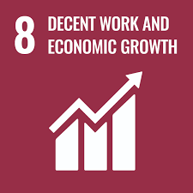
SDG 8: Decent Work and Economic Growth
SDG 8: Promote sustained, inclusive and sustainable economic growth, full and productive employment and decent work for all
It seeks to ensure that all people have access to safe and secure working environments, as well as decent wages, benefits, and social protection
Global unemployment rate reached 5.8% in 2022
Female and men unemployment rates are at the same level (2022)
The unemployment rate in Europe is 7.4% for women and 6.7% for men
Agricultural sector is the largest industry, employing over 1 billion people. Many workers in the industry have poorly paid jobs that prevent them of living a decent live.

Slide 20
SDG 8: Agriculture Contribution
Farmers can get organized in unions to exploit economies of scale and have a better access to markets
Smallholder-driven agriculture has the potential to boost economic development in developing countries and rural areas
Promote the purchase of local agricultural produce
Investments in agriculture can create jobs throughout the value chain, from farming and processing to distribution and marketing
Strengthening market value chains can connect farmers to the market, ensuring better prices to their products.
Agriculture offers opportunities for innovation and entrepreneurship in areas such as agri-tech, sustainable farming practices, and agro-processing.

Slide 21
SDG 10: Reduced Inequalities
SDG 10: Reduce inequality within and among countries
The goal emphasizes the need to empower and promote the social, economic, and political inclusion of all individuals and groups, regardless of their age, gender, disability, race, ethnicity, or other characteristics
The income difference between countries decreased by 37% from 1990 until 2019
Covid19 triggered the largest inequality increase between countries the last three decades (4.4%)
280.6 million global migrants in 2020—representing about 4% of the world’s population

Slide 22
SDG 10: Agriculture Contribution
Modifying trade, policy measures e.g. Tariffs, can give greater access to foreign markets and export growth. Subsequently, employment, wages, economic output and government revenue can improve in developing countries.
Eliminating inequalities in resource access (land, water etc.) ensures that marginalized groups, including smallholders and women farmers, have equal opportunities to engage in agriculture
Invest in education and skill development in vulnerable and low-income communities
Combat discrimination through awareness campaigns, promoting social inclusiveness and supporting anti-discrimination laws

Slide 23
SDG 12: Responsible Consumption and Production
SDG 12: Ensure sustainable consumption and production patterns.
Efficient use of natural resources and reduce waste and pollution.
Minimizing food waste along the supply chain is crucial in addressing responsible consumption.
SDG 12 aims to halve per capita global food waste along production and supply chains, including post-harvest losses.

Slide 24
SDG 12: Responsible Consumption and Production
Food waste per country
Country | Waste Production per capita kg | Total waste generation million metric tones
Cyprus | 644 | 2.2
Greece | 524 | 24.6
Spain | 472 | 105.9
Italy | 487 | 174.9

Slide 25
SDG 12: Agriculture Contribution
Educate consumers about the environmental and social impacts of their food choices, promoting responsible consumption
Implementation of better post-harvest handling practices and distribution. Gentle handling of produce during harvesting, sorting, and packing reduces physical damage that can lead to premature spoilage
Proper choice of packaging can help protect the product from external factors like air, light and physical damage. Modified Atmosphere Packaging (MAP) can extend perishables life by controlling carbon dioxide and oxygen levels or by applying Sulphur dioxide

Slide 26
SDG 12: Agriculture Contribution
Minimize the time between harvesting and packaging to reduce exposure to unfavorable conditions
The use of cold storage facilities can help minimize food waste by extending the shelf life of perishable goods, prevent spoilage, and reduce post-harvest losses
Adopting the principles of circular economy and the practices that goes with it (composting, agroforestry etc.), can reduce the waste generation.

Slide 27

SDG 13: Climate Action
SDG 13: Take urgent action to combat climate change and its impacts.
Target 13.1 aims to strengthen the resilience and adaptive capacity to climate-related hazards
The Earth's average temperature has already risen by about 1.2 º C above pre-industrial levels,
Global sea levels have risen by an average of about 20 cm since the late 19th century,
Global carbon dioxide (CO₂) emissions reached approximately 37.12 billion metric tons in 2022.

Slide 28
SDG 13: Agriculture Contribution
Enhance soil carbon content through practices like adding organic matter, cover cropping, and agroforestry, which can mitigate climate change
Produce bioenergy from agricultural residues and waste, reducing the reliance on fossil fuels and promoting sustainable energy sources.
Climate-smart farming, water-efficient irrigation systems and agroforestry are some adaptations measures that farmers can implement.

Slide 29
SDG 13: Agriculture Contribution
Deforestation for agricultural expansion needs to come to a halt and minimize the use of synthetic fertilizers
Pioneering agricultural techniques can sequestrate carbon from the atmosphere, but the potential depends on the price of carbon
Sustainable agriculture that prioritize soil health, biodiversity conservation, and climate resilience. e.g. organic farming and integrated pest management

Slide 30
SDG 15: Life on land
SDG 15: Protect, restore and promote sustainable use of terrestrial ecosystems, sustainably manage forests, combat desertification, and halt and reverse land degradation and halt biodiversity loss.
Forest cover 31% of the earth’s surface, providing habitat for millions of species, purifying the air we breath, filtering the water we drink and combating climate change through carbon sequestration.
Almost 90% of the global deforestation is due to agricultural expansion for croplands (49.6%) and livestock grazing (38.5%). Combined with the use of agrochemicals and monoculture, this leads to habitat destruction and biodiversity loss.

Slide 31
SDG 15: Agriculture Contribution
Focus needs to shift towards increasing productivity rather than agricultural expansion, avoiding deforestation
Integrated pest management and conservation agriculture can protect biodiversity and help prevent soil erosion, land degradation and desertification
Involve local communities in the management and conservation of natural resources, promoting sustainable land use practices
Promote the cultivation of native and heirloom crop varieties and incorporate wild vegetation in agricultural landscapes to support local biodiversity
Incorporate tree planting into agricultural landscapes to restore degraded areas, improve soil fertility, and provide habitat for biodiversity

Slide 32
